Slide 1

Week 7
JINGYA LI

Slide 2
Outline
Exercises for Reading Text A
Group Presentation
Academic Reading Skills
Exercises

Slide 3
Task 1
D
M
A
H
O
L
B
P
E
J
S
G
T
R
K

Slide 4
Task 2
B

Slide 5
Academic Reading Skills
Determining Differences Between Facts and Opinions

Slide 6

Group Presentation

Slide 7
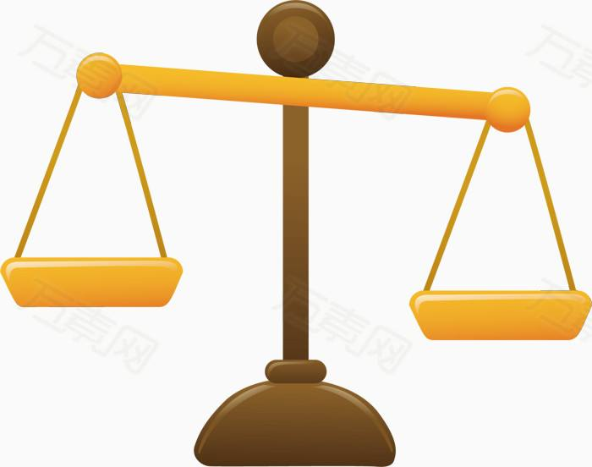
Every man has a right to be wrong in his opinions. But no an has a right to be wrong in his facts.
Baruch Bernard M (1870-1965)
American Financier

Slide 8



Fact and Opinion
Many readers never question what they read. They tend to accept everything they read as fact. “If it’s in print, it must be true.” they say.
What’s wrong with this thinking?

Slide 9
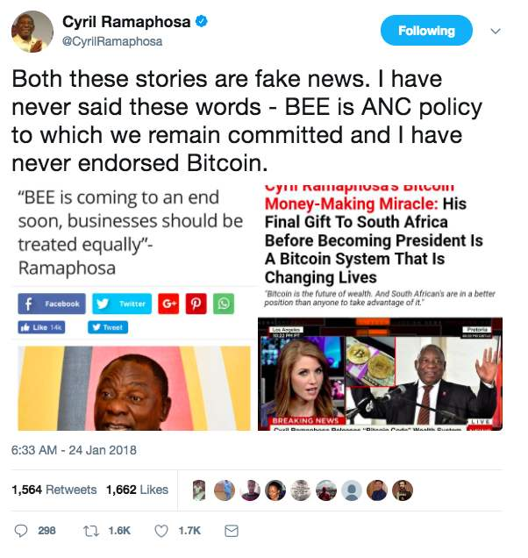
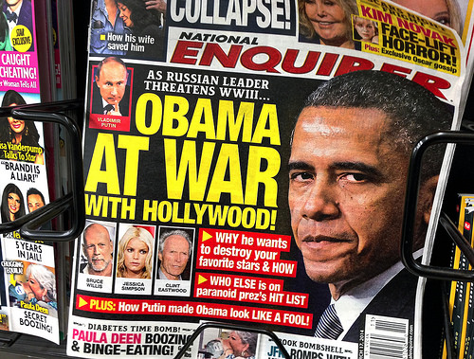
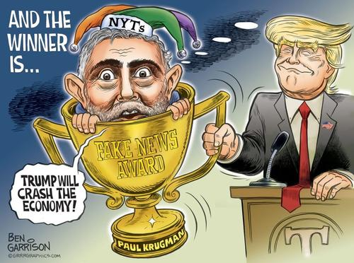
Some people believe everything they read.

Slide 10
Differentiating facts and opinions
Not everything in print is true.
Many people misread what is factual because they do not:
Distinguish between facts and opinions
Make inferences
Pick up on the author’s bias or tone
Use their own prior knowledge

Slide 11
Facts and Opinions
Fact
An evidence that can be proven by observation or experiment
can be based on experience
specific and certain
Opinion
A statement of personal feeling, value, belief, interpretation, or judgement
can vary between people
do not rely on evidence

Slide 12
Fact or opinion?
Checking questions:
Can it be proved or checked out? Now?
Can there be any other point of view?
If you answered yes to the first question and no to the second question, this is a fact.

Slide 13
Tips
Statements that contain words like good, bad, hard (para.11 in Text A), great, which shows personal values are opinions.
Statements reporting other people’s opinions are facts.
E.g. The head teacher said our students are very polite and respectful.
Statements by the writer that something is necessary, or wanted or liked are opinions.
E.g. Everyone can enjoy our new menu in the cafeteria.
Statements show predictions are opinions.
E.g. Students would welcome a change in school uniform policy.

Slide 14
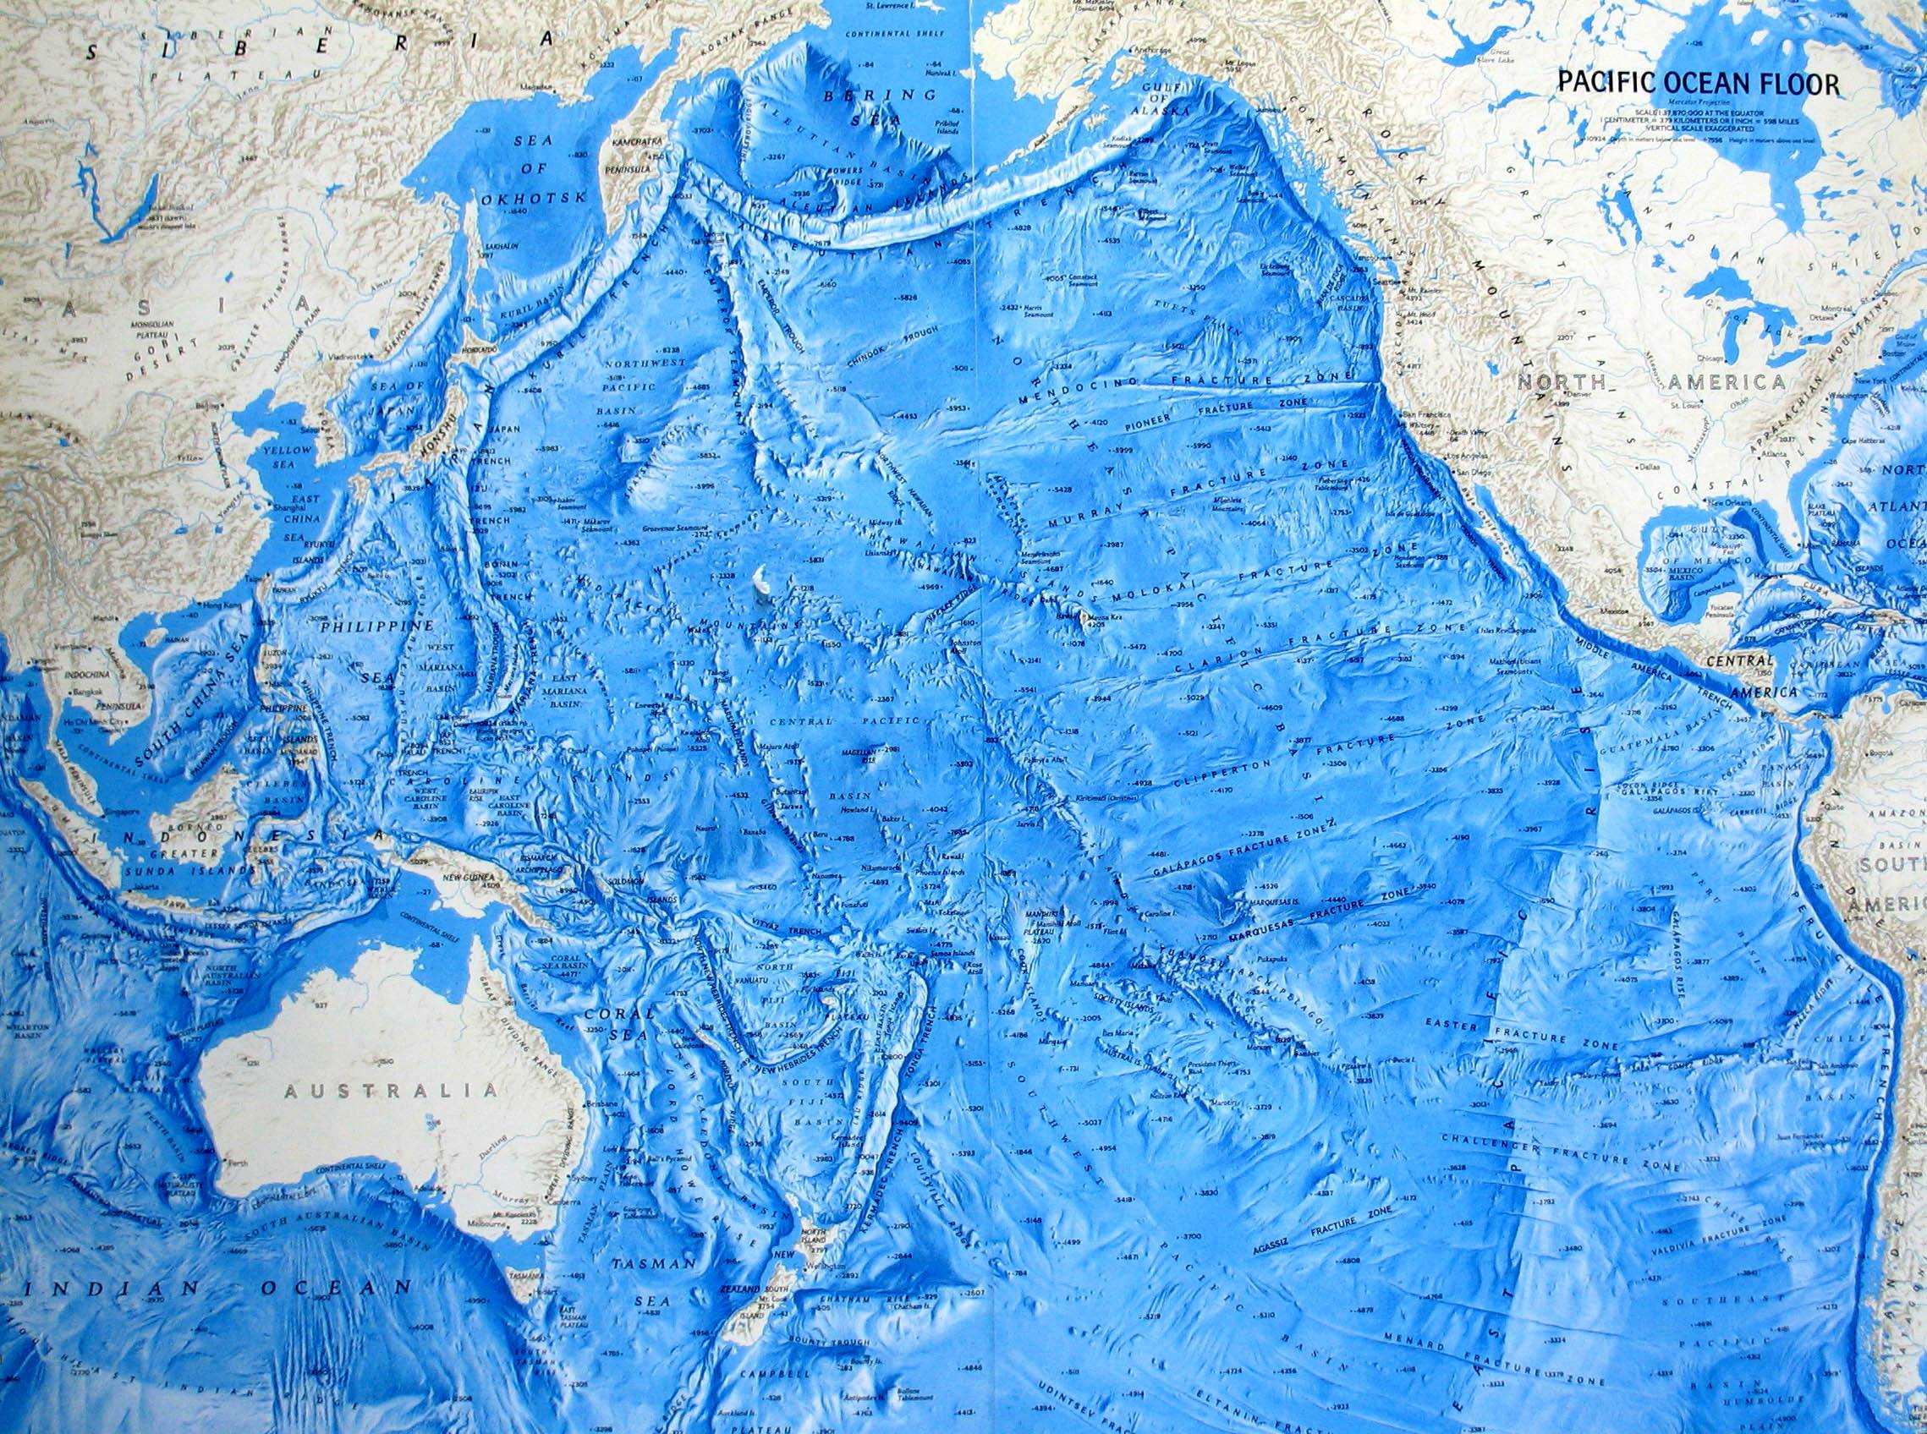
Fact or opinion?
The Pacific Ocean is the largest ocean on earth.
Being in the ocean is scary.

Slide 15
Fact or opinion?
fact
What people hear is often a/an
What people see is often a/an
What people believe is often a/an
fact
opinion

Slide 16
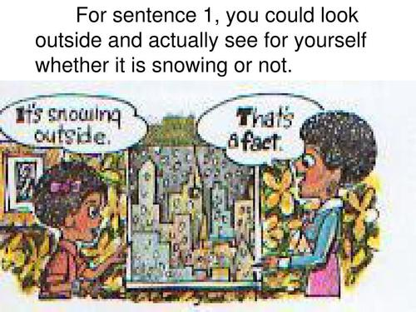
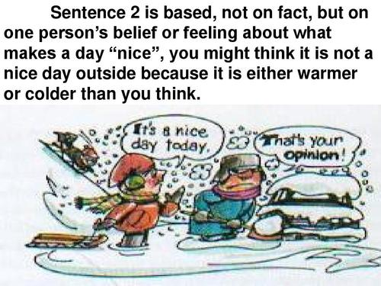
Fact or opinion?

Slide 17
Exercise 1: Find the fact
Jason wants to become a pilot in the Air Force, but the Air Force has turned him down.
Some of the possible reasons are given below. Decide which of these are facts.
(Assume every fact is correct.)
He is shorter than Air Force regulations permit.
Jason will make a poor pilot.
He gets sick whenever he boards a plane.
No one would want to fly with him.

Slide 18
Fact or opinion?
If we want to improve the public visibility of experimentalists and place experimentalists in their rightful place in the pantheon of popular physics, the main initiative would have to come from experimentalists themselves.
Without the 1968 experiments of Kendall, Friedman and Taylor at the Stanford Linear Accelerator Center (SLAC), quarks would have remained a mere theory, a will-o-wisp whose existence was confidently postulated but never proven.
Opinion
Fact

Slide 19
Markers used for positions or opinions
View marker:
to assume, to believe, to suggest, analysis, judgement
Contrast markers:
however, yet
Qualifying markers
always, should, likely to show certainty or probability
Assessment markers
mistake, profound, extremely to show their evaluation.

Slide 20
Types of facts
Examples
Ideas
Statistics
Research findings
Personal experience

Slide 21
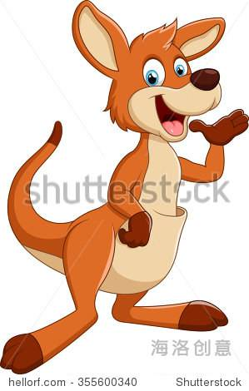
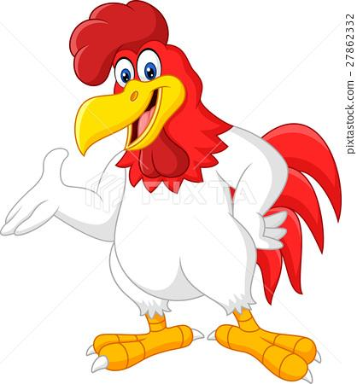
Why do we need to distinguish the differences?
Suppose you were the boss, which employee would you prefer to give a raise?
Employee B
“I really think I should get a raise. I’ve met all of my production goals since I’ve been here and my evaluations have been excellent.”
opinion
opinion
+
Employee A
“I really think I should get a raise because I deserve it.”
fact

Slide 22
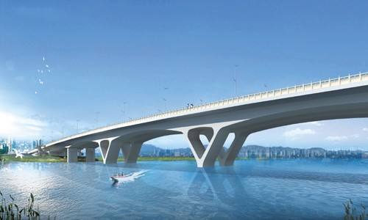

Opinion + Fact $>$ Opinion
Make an argument more convincing
Judge more wisely with your supporting evidence (facts)
Your Opinion
(topic sentence/argument)
Facts
(supporting evidence)

Slide 23
Task 1
F/O
F/O
O
O
O
F/O
F/O
F

Slide 24
Task 2: identify what type of markers were used
Assessment marker
“Stronger” shows the author’s evaluation.
Assessment marker
“Elaborate” shows the author’s evaluation.
Qualifying marker, assessment marker
“Tend to” shows a degree of uncertainty.
“Predominantly” shows the probability.
View marker, qualifying marker, assessment marker
“Argue” as a reporting verb, shows the following part is the author’s opinion.
“Should” shows the author’s certainty.
“More robust” shows evaluation.

